Slide 1

TEAM 4 CMM MOVIE
KOREA IT SCHOOL
Here is where your presentations begins

Slide 2
TABLE OF CONTENTS
01
ABOUT US
02
INTRODUCE
03
CMM MOVIE
04
Q&A and Discussion
KOREA IT SCHOOL
01
02
Learn More About Us
Overview of a Basic Online Movie Streaming Website
03
04
Details about Our Final Course Project
Addressing Questions and Discussions

Slide 3
01
ABOUT US
KOREA IT SCHOOL
01
Learn More About Us

Slide 4
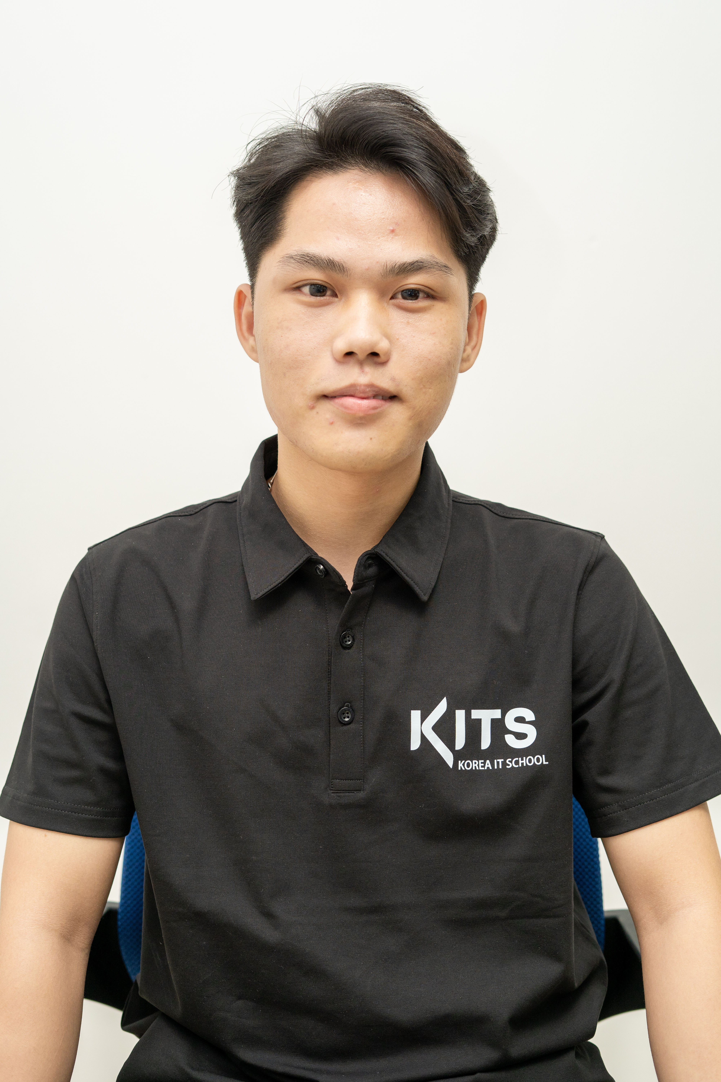
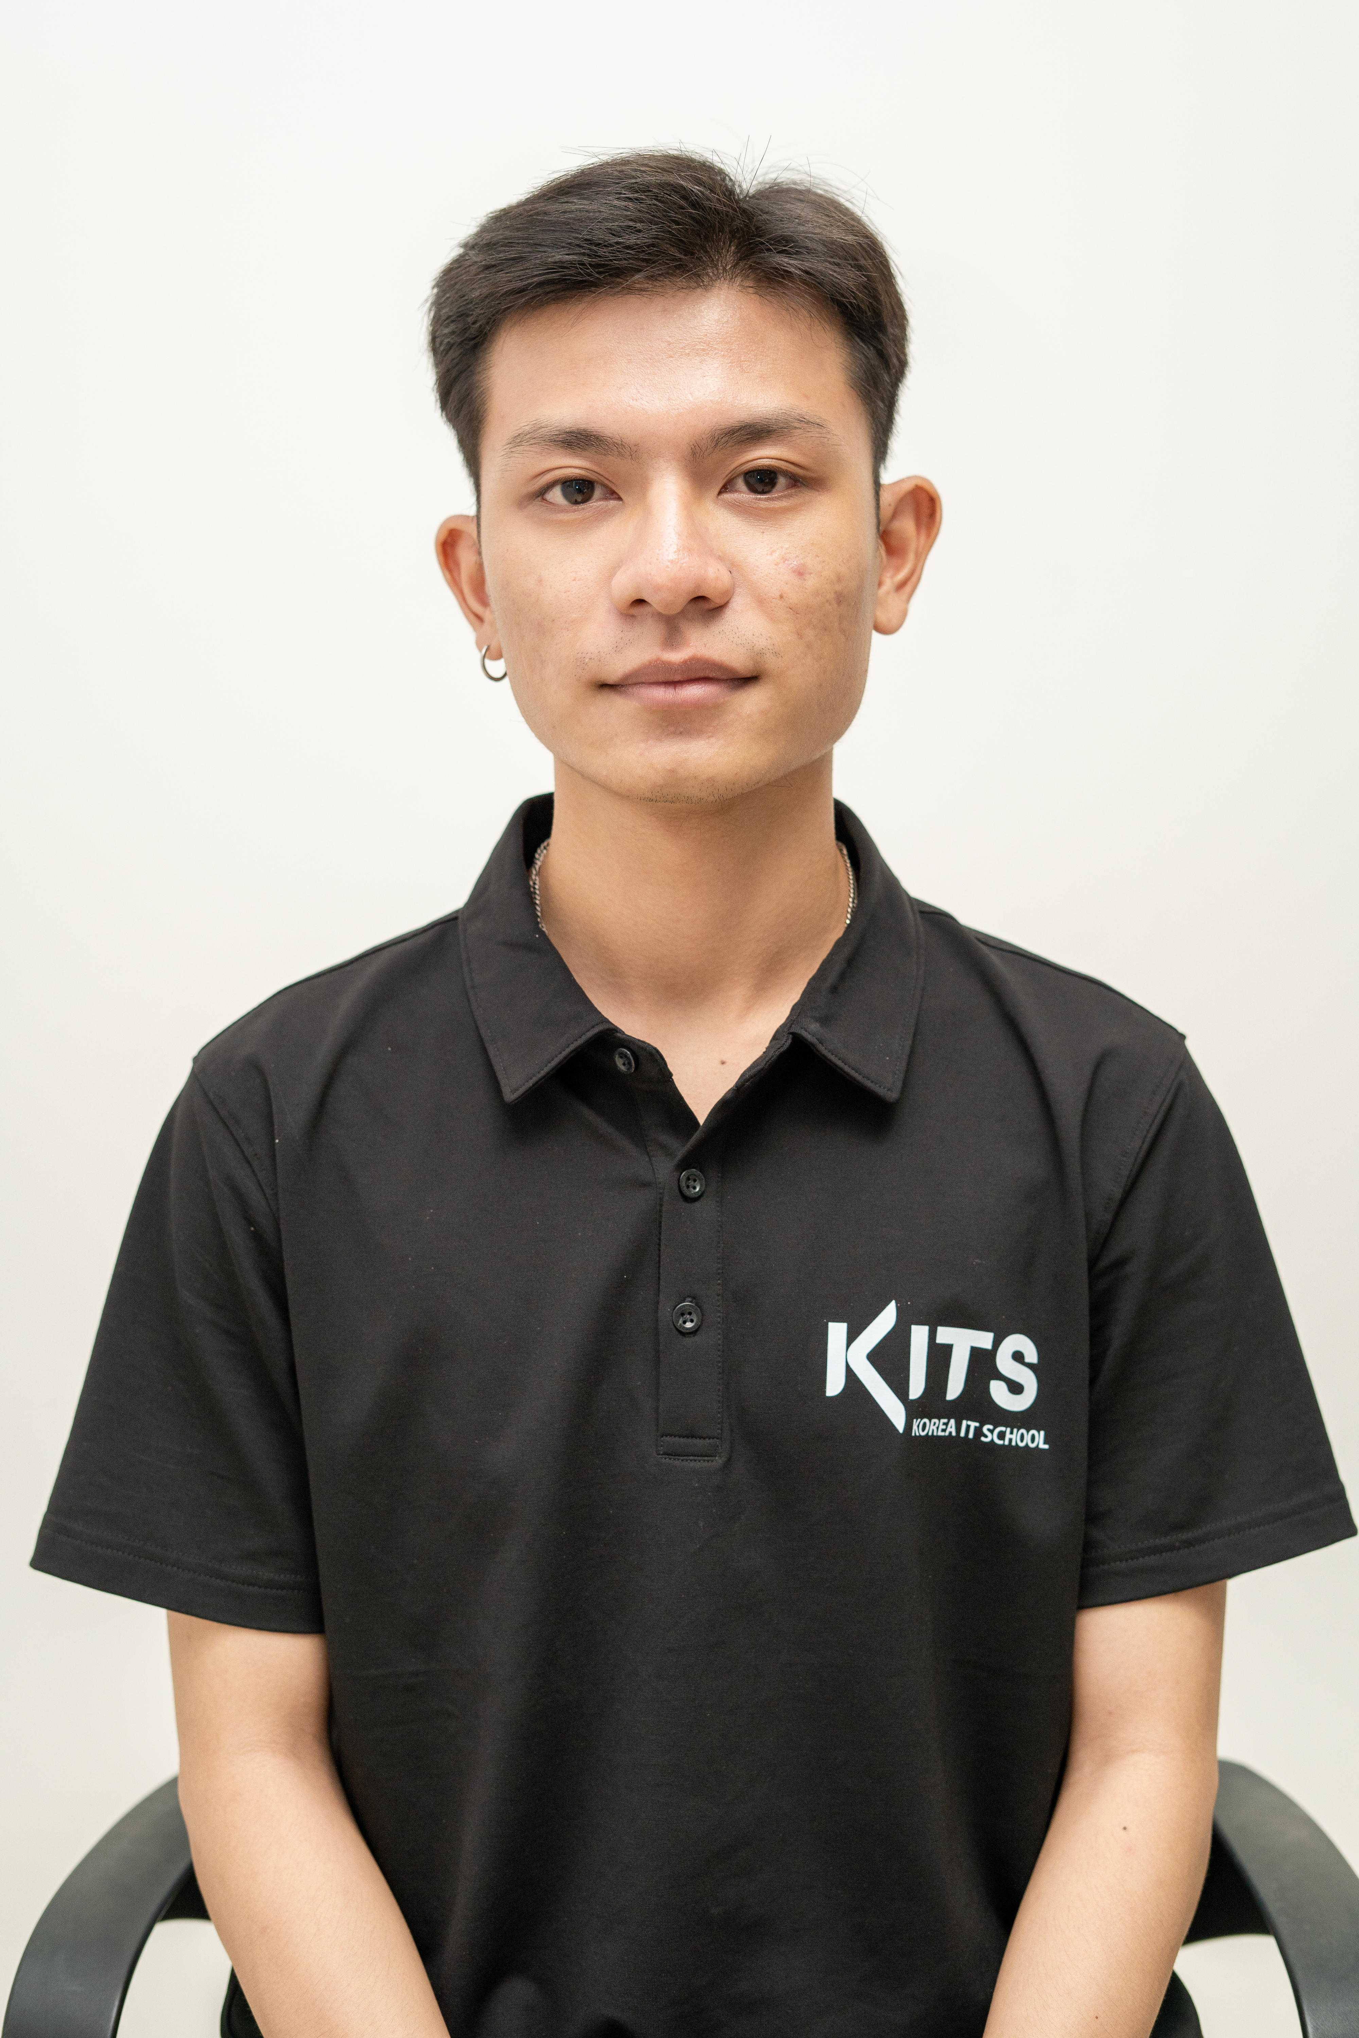
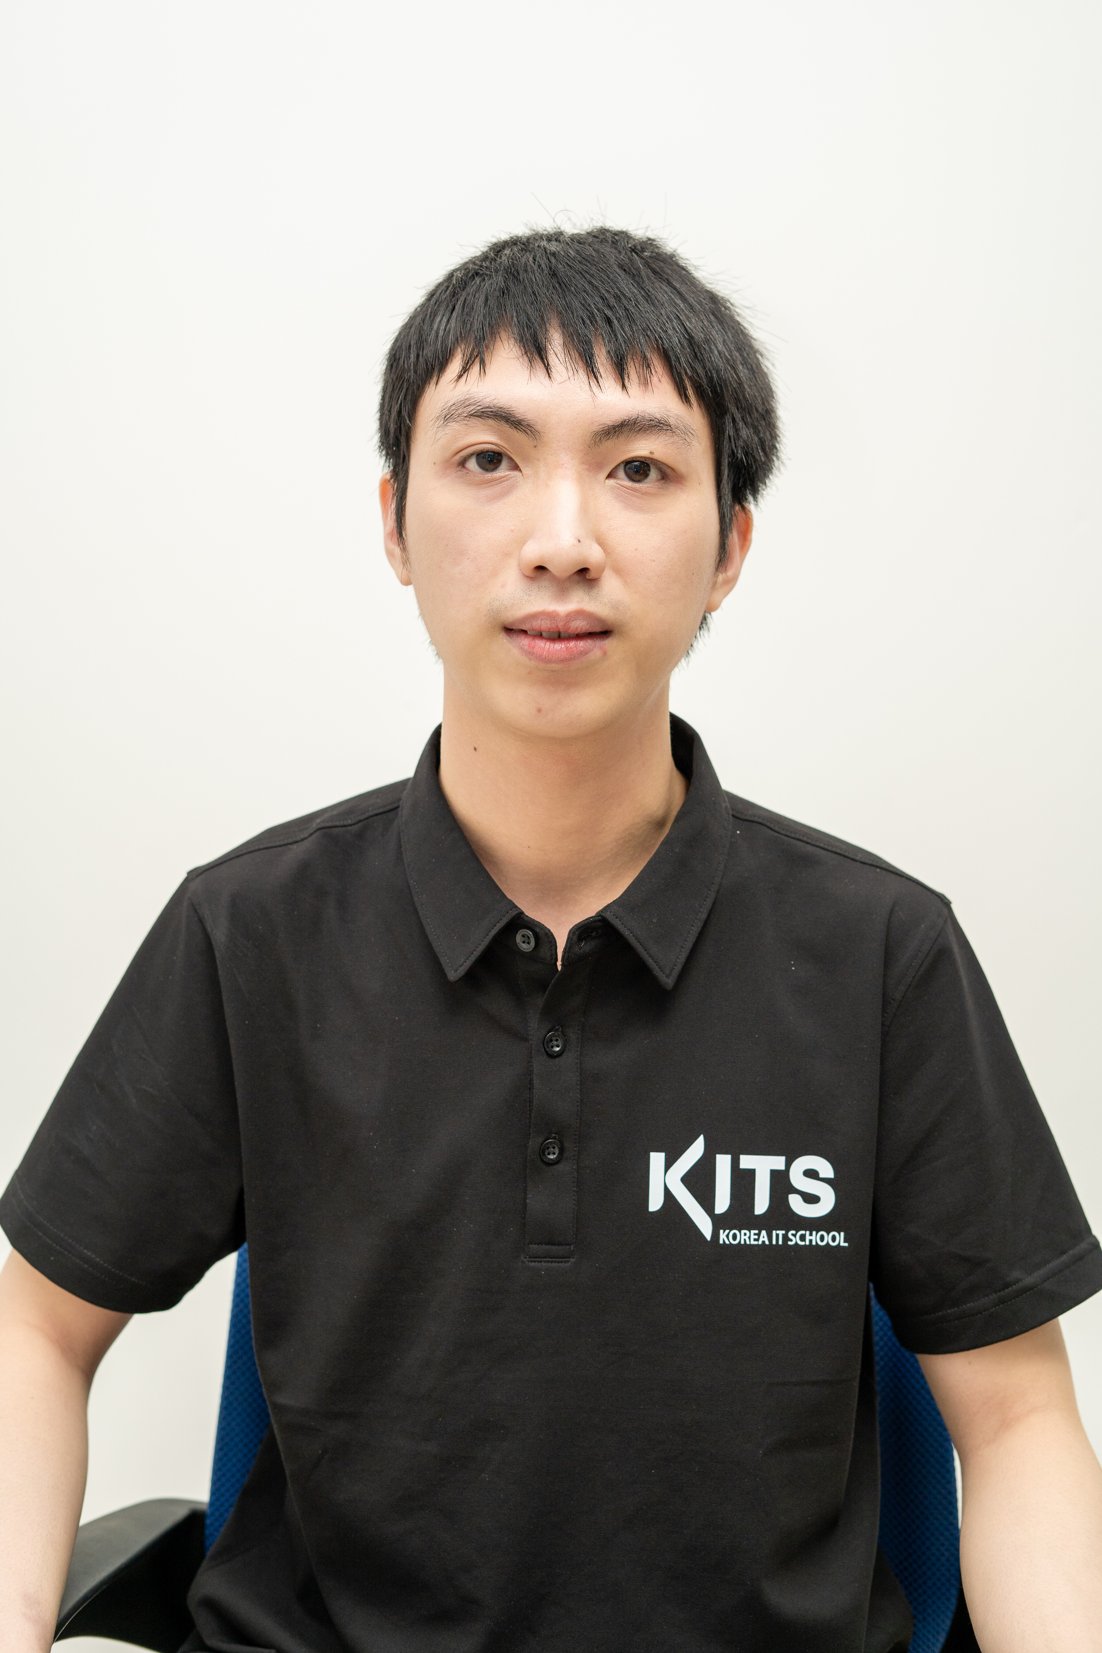
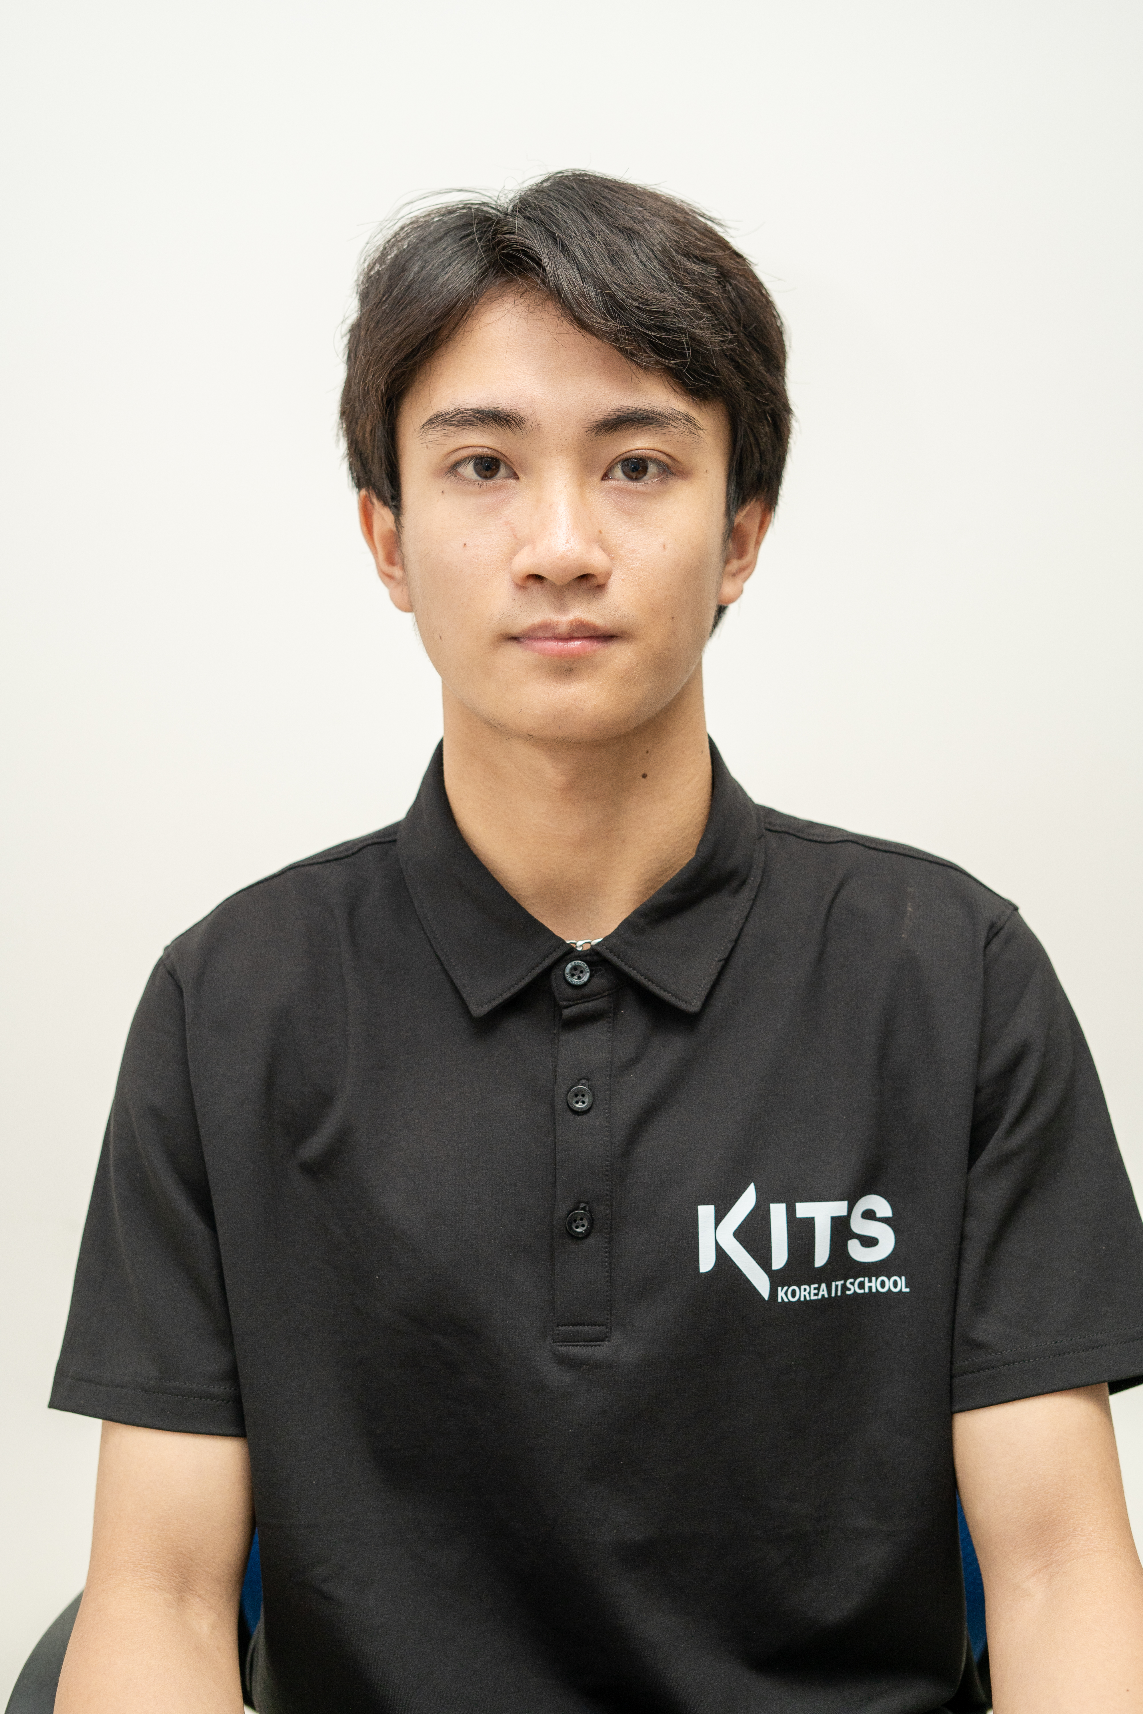
ABOUT US
VŨ VĂN MINH
KOREA IT SCHOOL
HỒ SỸ ĐẠT
TRẦN KHÁNH QUANG BẢO
NGUYỄN ĐĂNG KHOA

Slide 5
INTRODUCE
KOREA IT SCHOOL
02
Overview of a Basic Online Movie Streaming Website

Slide 6
Movie Streaming Website
KOREA IT SCHOOL
Main Features of an Online Movie Streaming Website

Slide 7
KOREA IT SCHOOL
In the daily life, everyone is facing to stress from work, and relationship. When having stress, you want to have way to relieve stress. Therefore, we make this website where everyone can watch film.

Slide 8
INTRODUCE
Movie Catalog
Video Player
02
Search Functionality
KOREA IT SCHOOL
01
03
The website should have a well-organized movie catalog that lists all the available movies.
The website should integrate a video player that enables users to watch movies directly on the site without the need for external players or downloads.
02
A search bar or advanced search options should be provided to allow users to search for specific movies based on titles, genres, actors, directors, or keywords.

Slide 9
INTRODUCE
05
User Accounts
Categories and Genres
User Ratings and Reviews
KOREA IT SCHOOL
04
06
Implement user registration and login features. Registered users can access personalized features like creating playlists, saving favorite movies, and managing their viewing history.
Categorize movies into different genres (e.g., action, drama, comedy) to make it easier for users to find movies that match their preferences.
05
Allow users to rate and write reviews for movies they have watched. This feature helps other users in making decisions about which movies to watch.

Slide 10
CMM MOVIE
KOREA IT SCHOOL
03
Details about Our Final Course Project

Slide 11
KNOWLEDGE USED
FRONTEND
BACKEND
KOREA IT SCHOOL
ReactJS
HTML
CSS
Ant Design
Redux(Rematch)
Java
Spring boot
MySQL
Docker
Maven

Slide 12
MAIN FEATURE
WATCH MOVIES ONLINE FOR FREE
SEARCH MOVIES ON DEMAND
WATCH MOVIES ONLINE WITH PAYMENT
MANAGE MOVIES WITH ADMIN
KOREA IT SCHOOL
01
03
02
04

Slide 13
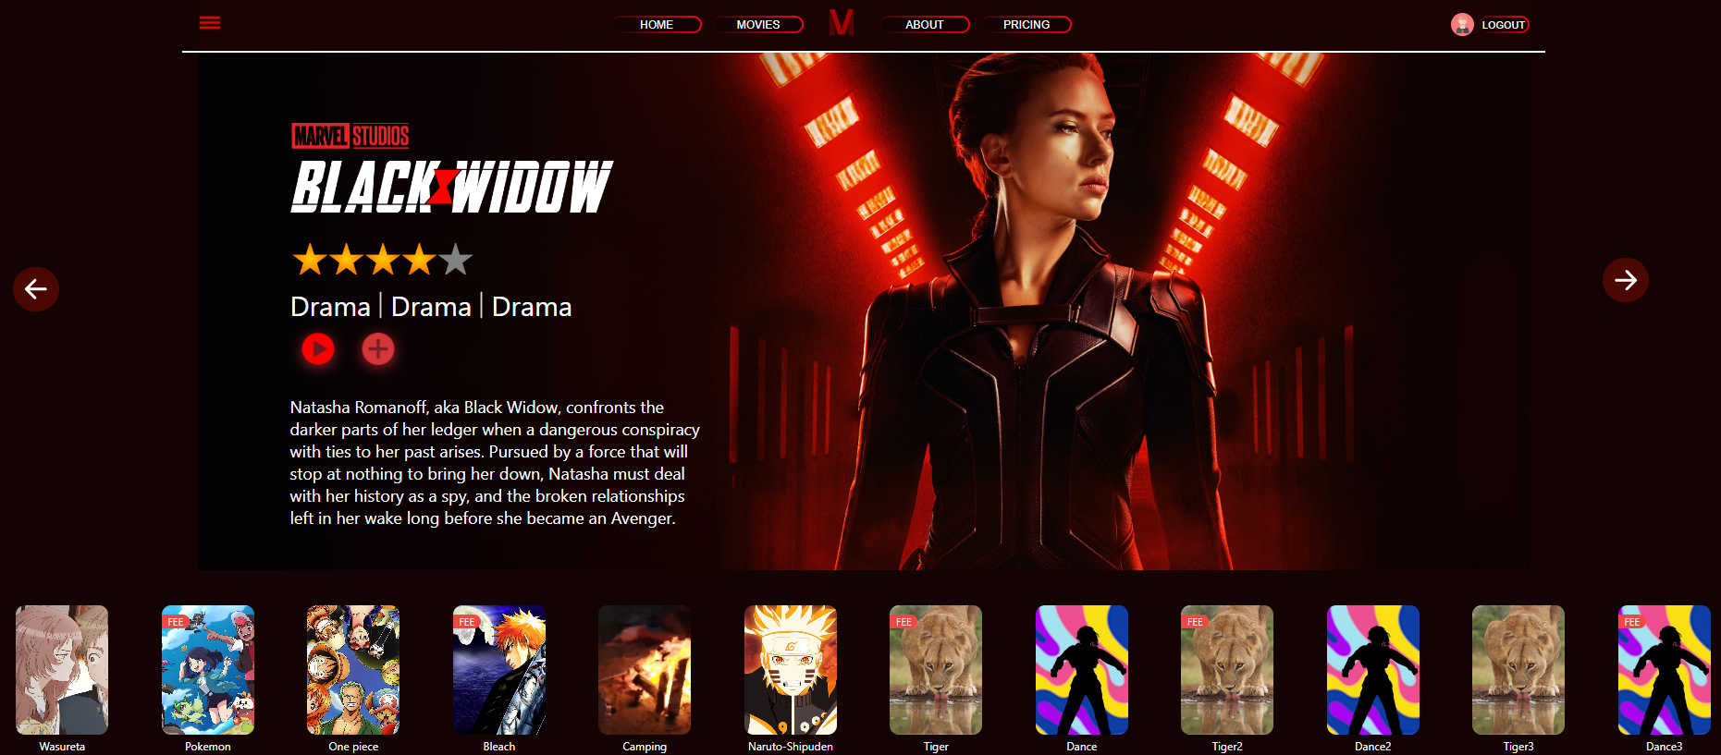
MAIN FEATURE
KOREA IT SCHOOL
HOME PAGE

Slide 14
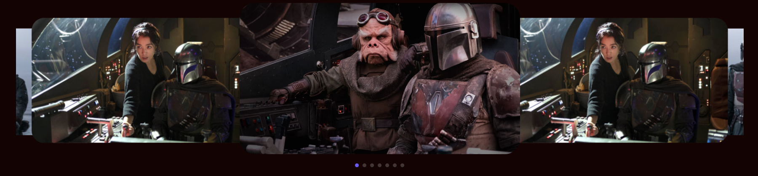
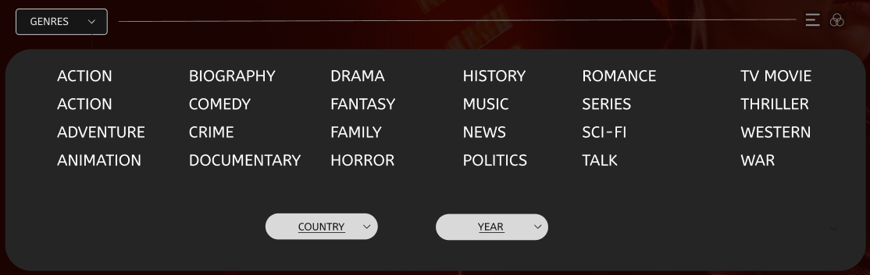
MAIN FEATURE
KOREA IT SCHOOL
POSTER
CLASSIFY MOVIES BY GENRE

Slide 15
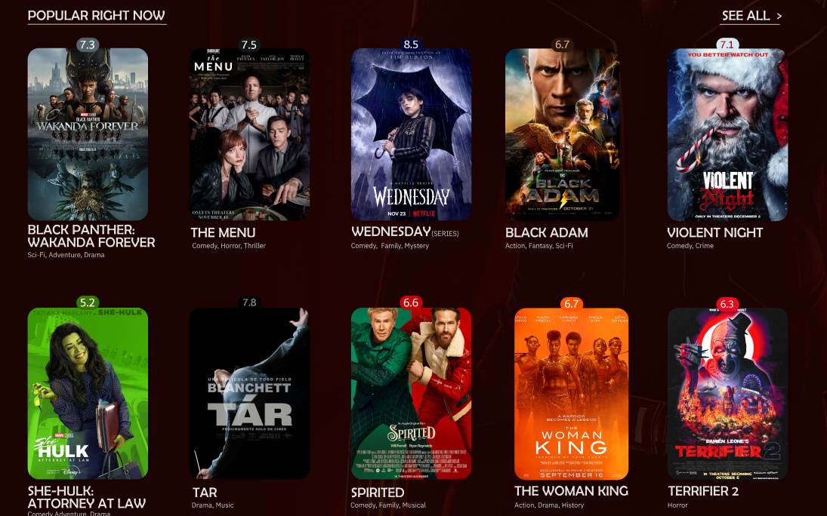
MAIN FEATURE
KOREA IT SCHOOL
POPULAR MOVIES LIST

Slide 16
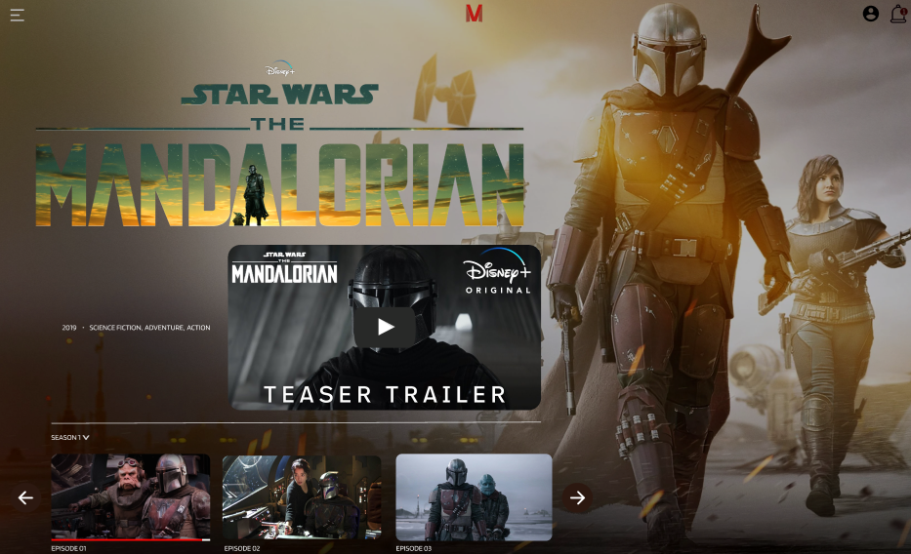
MAIN FEATURE
KOREA IT SCHOOL
MOVIE TRAILER

Slide 17
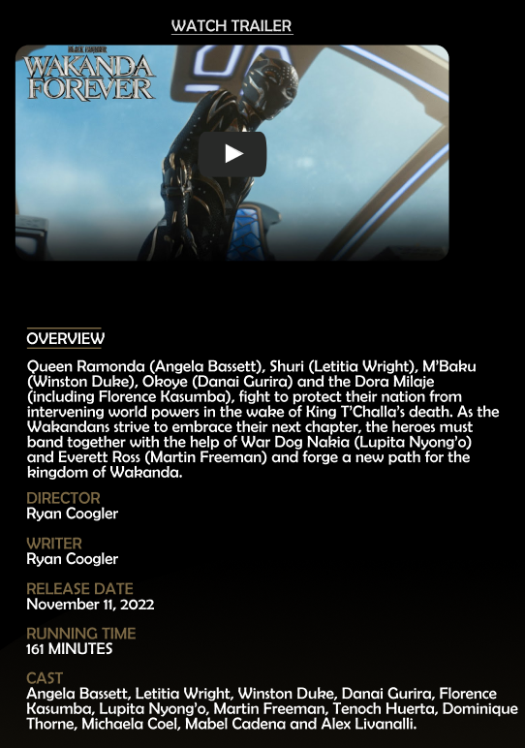
MAIN FEATURE
KOREA IT SCHOOL
DETAILS OF THE MOVIE

Slide 18
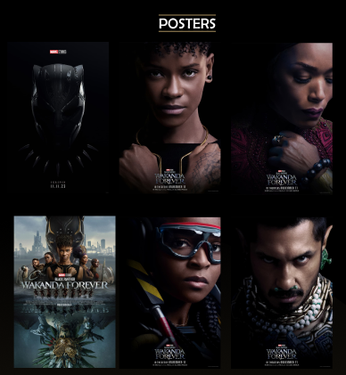
MAIN FEATURE
KOREA IT SCHOOL
POSTER OF LEADING ACTORS

Slide 19
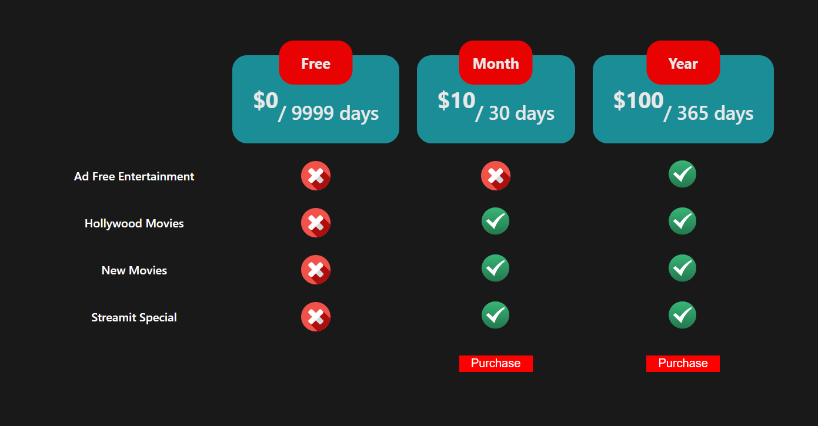
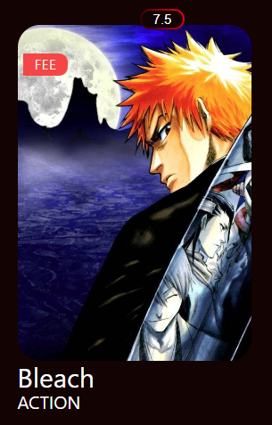
MAIN FEATURE
KOREA IT SCHOOL
FREE FILM
PAY TO ENJOY THE BENEFITS

Slide 20
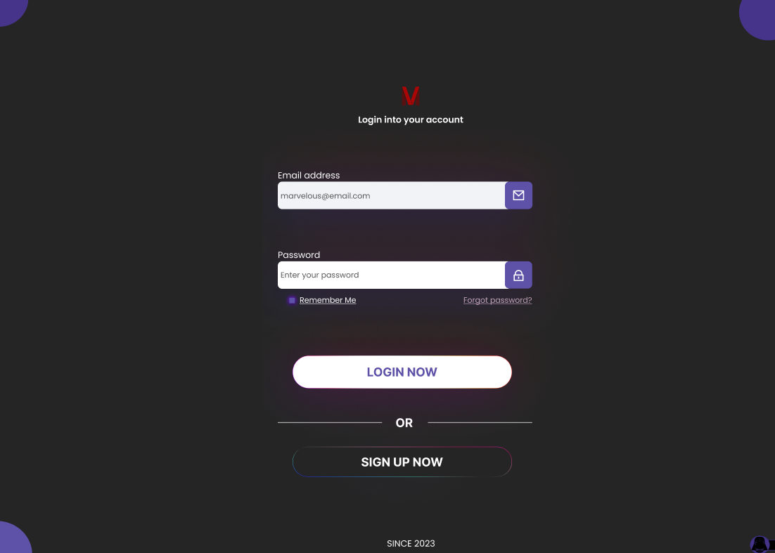
MANAGE MOVIES WITH ADMIN
KOREA IT SCHOOL
LOGIN SCREEN

Slide 21
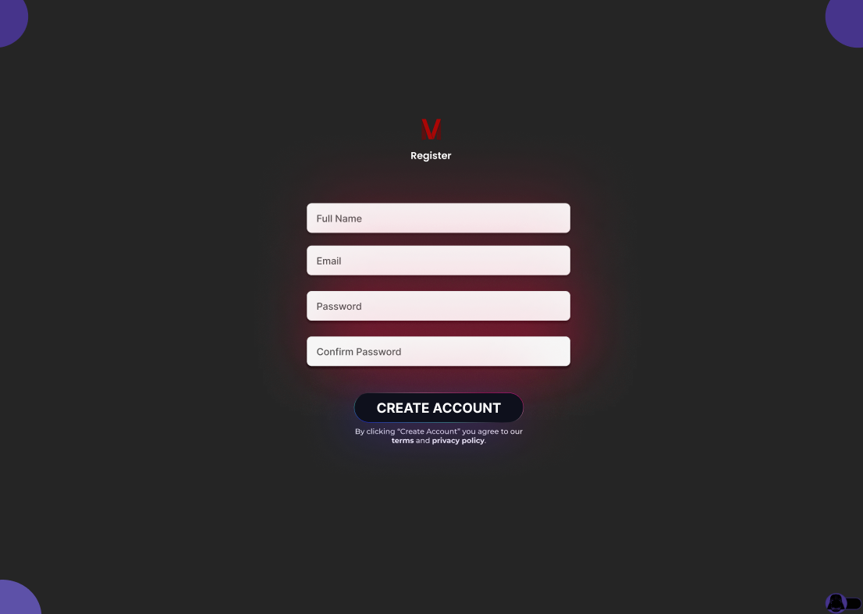
MANAGE MOVIES WITH ADMIN
KOREA IT SCHOOL
SIGN-UP SCREEN

Slide 22
VISIT WEBSITE !
KOREA IT SCHOOL
Visit our website to learn more about our features…

Slide 23

KOREA IT SCHOOL
SUMMARY
KNOWLEDGE
GOALS
Help the students apply their knowledge into the real world:
Develop a simple Movies Web: CMM Movies Web App.
Complete this final project to finish the course.
FRONTEND: ReactJS, HTML
CSS, Ant Design, Redux(Rematch)
SKILLS
BACKEND: Java, Spring boot,
MySQL, Docker, Maven
TEAMWORK
HOW TO USE GIT
UNDERSTANDING
A REAL-WORLD PROJECT
DATABASE MANAGEMENT

Slide 24
Q&A DISCUSSION
KOREA IT SCHOOL
04
Addressing Questions and Discussions

Slide 25

THANK YOU FOR LISTENING
KOREA IT SCHOOL
TEAM 4 CMM MOVIE
Do you have any questions?
Team 4- KOREA IT SCHOOL
Hồ Sỹ Đạt
Trần Khánh Quang Bảo
Nguyễn Đăng Khoa
Vũ Văn Minh

